Slide 1
CS35L-5
Week 8 Lec1

Slide 2
Building an executable file
source
code
object
code
linker
executable
file
compiler
Translates programming
language statements into
cpu’s machine-language
instructions
Resolves interconnecting
references

Slide 3
Linking and Loading
Program life cycle:
write -> compile -> link -> load -> execute
Linker collects procedures and links them together - multiple object files into one executable
Loading: This refers to copying a program image from hard disk to the main memory in order to put the program in a ready-to-run state.

Slide 4
source
code
compiler
object
code
linker
executable
file
object
code
library
A previously compiled
collection of standard
program functions

Slide 5
Static Linking
Carried out only once to produce an executable file
If static libraries are called, the linker will copy all the modules referenced by the program to the executable
Static libraries are typically denoted by the .a file extension and created using the ar (archiver) program

Slide 6
Dynamic Linking
Allows a process to add, remove, replace or
relocate object modules during its execution.
If shared libraries are called:
Only copy a little reference information when the executable file is created
Complete the linking during loading time or running time
Dynamic libraries are typically denoted by the .so file extension
.dll on Windows

Slide 7
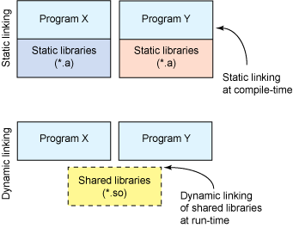

Slide 8
Dynamic linking
Unix systems: Code is typically compiled as a dynamic shared object (DSO)
Dynamic vs. static linking resulting size $ gcc -static hello.c -o hello-static $ gcc hello.c -o hello-dynamic $ ls -l hello 80 hello.c 13724 hello-dynamic 383 hello.s 1688756 hello-static
If you are the sysadmin, which do you prefer?

Slide 9
Advantages of dynamic linking
The executable is typically smaller since not entire external program is in the executable.
When the library is changed, the code that references it does not usually need to be recompiled.
The executable accesses the .so at run time; therefore, multiple programs can access the same .so at the same time
Memory footprint amortized across all programs using the same .so
Load time reduced. (Static - takes constant load time)

Slide 10
Smaller is more efficient
object
file
object
file
static linking
function
library
function
library
executable
files
object
file
object
file
dynamic linking
pointer
pointer
shared
function
library

Slide 11
Disadvantages of dynamic linking
Performance hit
Need to load shared objects (at least once)
Need to resolve addresses (once or every time)
What if the necessary dynamic library is missing?
What if we have the library, but it is the wrong version?

Slide 12
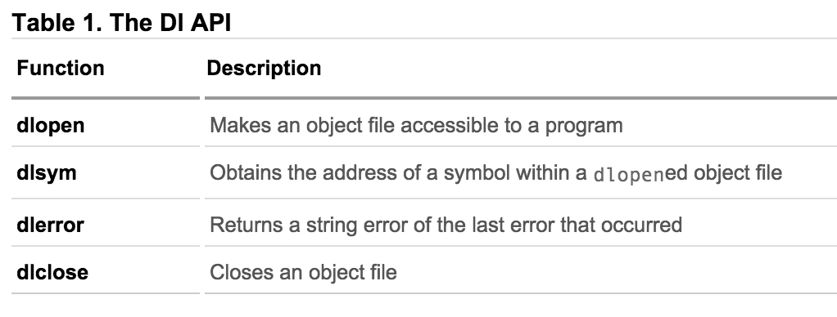
How are libraries dynamically loaded?

Slide 13
In all,
Static Libraries: installed into executable before program can be run
Shared Libraries: loaded at program start-up (if not already) and shared between programs
Dynamically Loaded Libraries: loaded and used at any time while a program is running

Slide 14
GCC Flags
-fPIC: Compiler directive to output position independent code, a characteristic required by shared libraries.
-lXXX: Link with "libXXX.so”
Without -L to directly specify the path, /usr/lib is used.
-Ldir: At compile time, find library from this path.
-Wl,rpath=.: -Wl passes options to linker. -rpath at runtime finds .so from this path.
-c: Generate object code from c code.
-shared: Produce a shared object which can then be linked with other objects to form an executable.
https://gcc.gnu.org/onlinedocs/gcc/Link-Options.html#Link-Options

Slide 15
Creating static and shared libs in GCC
●
mymath.h
●
mul5.c
●
add1.c
#ifndef MY_MATH_H
#include "mymath.h"
#include "mymath.h"
#define MY_MATH_H
void mul5(int *i)
void add1(int *i)
void mul5(int *i);
{
{
void add1(int *i);
*i *= 5;
*i += 1;
#endif
}
}
gcc -c mul5.c -o mul5.o gcc -c add1.c -o add1.o
ar -cvq libmymath.a mul5.o add1.o ----> (static lib)
gcc -shared -fpic -o libmymath.so mul5.o add1.o -----> (shared lib)
●
●
●
●

Slide 16
Dynamic loading
#include <stdio.h>
#include <dlfcn.h>
int main(int argc, char* argv[]) {
int i = 10;
void (*myfunc)(int *); void *dl_handle;
char *error;
dl_handle = dlopen("libmymath.so", RTLD_LAZY);//RTLD_NOW
if(!dl_handle) {
printf("dlopen() error - %s\n", dlerror()); return 1;
}
//Calling mul5(&i);
myfunc = dlsym(dl_handle, "mul5"); error = dlerror();
if(error != NULL) {
printf("dlsym mul5 error - %s\n", error); return 1;
}
myfunc(&i);
//Calling add1(&i);
myfunc = dlsym(dl_handle, "add1"); error = dlerror();
if(error != NULL) {
printf("dlsym add1 error - %s\n", error); return 1;
}
myfunc(&i);
printf("i = %d\n", i);
dlclose(dl_handle);
return 0;
}
Copy the code into main.c gcc main.c -o main -ldl
You will have to set the environment variable LD_LIBRARY_PATH to
include the path that contains libmymath.so
●
●
●

Slide 17
Lab 8
Write and build simple cos(sqrt(3.0)) program in C
Use ldd to investigate which dynamic libraries your hello world program loads
Use strace to investigate which system calls your hello world program makes
Use “ls /usr/bin | awk ‘NR%101==SID%101’” to find ~25 linux commands to use ldd on
Record output for each one in your log and investigate any errors you might see
From all dynamic libraries you find, create a sorted list
Remember to remove the duplicates!

Slide 18
Attributes of Functions
Used to declare certain things about functions called in your program
Help the compiler optimize calls and check code
Also used to control memory placement, code generation options or call/return conventions within the function being annotated
Introduced by the attribute keyword on a declaration, followed by an attribute specification inside double parentheses

Slide 19
Attributes of Functions
__attribute__ ((__constructor__))
Is run when dlopen() is called
__attribute__ ((__destructor__))
Is run when dlclose() is called
Example:
__attribute__ ((__constructor__))
void to_run_before (void) {
printf("pre_func\n");
}

Slide 20
Homework 8
Split randall.c into 4 separate files
Stitch the files together via static and dynamic linking to create the program
randmain.c must use dynamic loading, dynamic linking to link up with randlibhw.c and randlibsw.c (using randlib.h)
Write the randmain.mk makefile to do the linking

Slide 21
Homework 8
randall.c outputs N random bytes of data
Look at the code and understand it
Helper functions that check if hardware random number generator is available, and if it is, generates number
Hw RNG exists if RDRAND instruction exists
Uses cpuid to check whether CPU supports RDRAND (30th bit of ECX register is set)
Helper functions to generate random numbers using software implementation (/dev/urandom)
main function
Checks number of arguments (name of program, N)
Converts N to long integer, prints error message otherwise
Uses helper functions to generate random number using hw/sw

Slide 22
Homework 8
Divide randall.c into dynamically linked modules and a main program
Don’t want resulting executable to load code that it doesn't need (dynamic loading)
randcpuid.c: contains code that determines whether the current CPU has the RDRAND instruction. Should include randcpuid.h and include interface described by it.
randlibhw.c: contains the hardware implementation of the random number generator. Should include randlib.h and implement the interface described by it.
randlibsw.c: contains the software implementation of the random number generator. Should include randlib.h and implement the interface described by it.
randmain.c: contains the main program that glues together everything else. Should include randcpuid.h (as the corresponding module should be linked statically) but not randlib.h (as the corresponding module should be linked after main starts up). Depending on whether the hardware supports the RDRAND instruction, this main program should dynamically load the hardware-oriented or software-oriented implementation of randlib.

